Slide 1
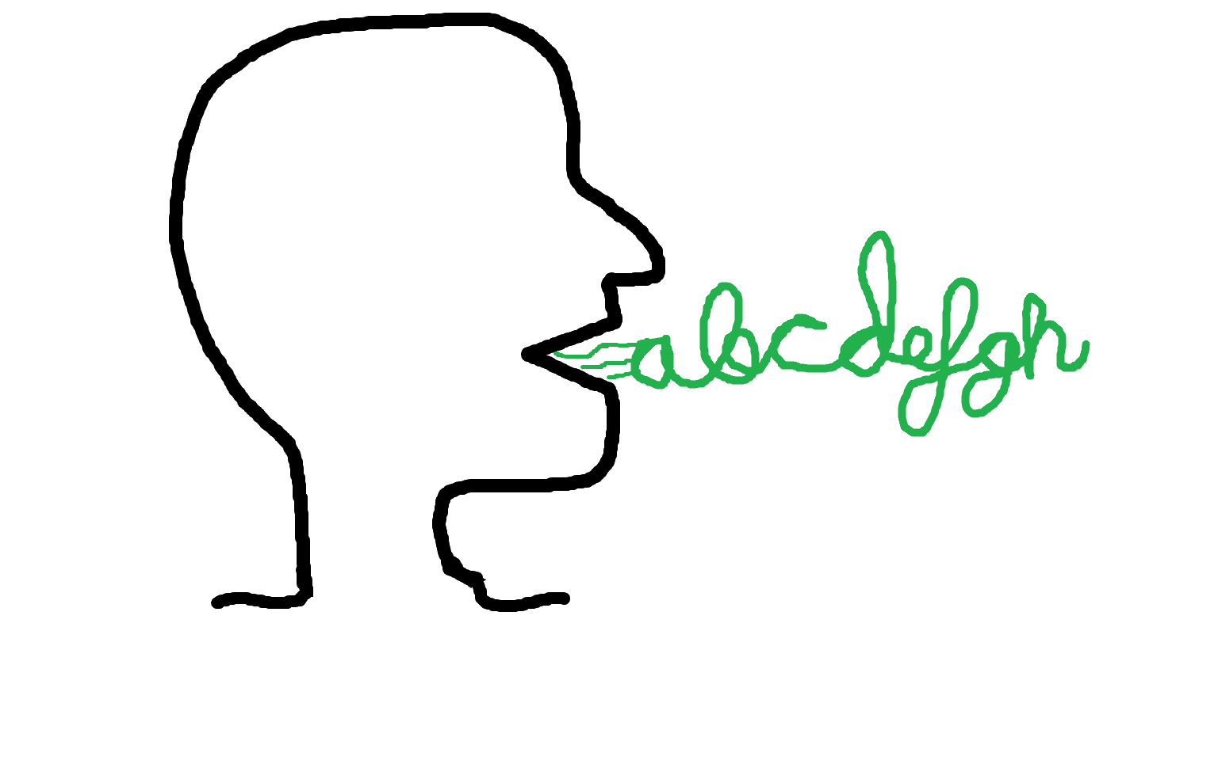

The Natural Approach (NA) in Language Education

Slide 2

What exactly is “The Natural
Approach”?
Simply put, it is a language teaching approach based on Krashen’s language acquisition theory.
It places great emphasis on comprehensible input and communication.
It was developed by Stephen Krashen and Tracy Terrell in the late 1970s as a communicative method for second language acquisition.

Slide 3






Comprehensible input
Input refers to any language exposure that a learner receives – spoken or written.
Comprehensible input refers to input that a learner can understand, even if they don’t know every word. It might be slightly above their current level but makes sense through context, gestures, or prior knowledge.
This person is happy.
This person is lotricious.
Not a real word, I made it up. The input was comprehensible, so you were able to figure out it meant “sad”.

Slide 4

Krashen’s language acquisition theory
It refers to the concept that people learn languages best when they are exposed to meaningful, understandable input in a low-stress environment --just like how children naturally acquire their first language.
It is based on Krashen’s 5 key hypotheses,
which can be remembered using the acronym MANIA.
M
A
N
I
A
onitor hypothesis
ffective filter hypothesis
atural order hypothesis
nput hypothesis
cquisition-learning hypothesis

Slide 5



The acquisition / learning hypothesis
The hypothesis claims that there are two distinctive ways to develop competence in a foreign or a second language. Acquisition and Learning.
Learning happens consciously and helps us monitor mistakes. It doesn’t necessarily lead to fluency.
Acquisition happens naturally through exposure, and it leads to fluency.

Slide 6


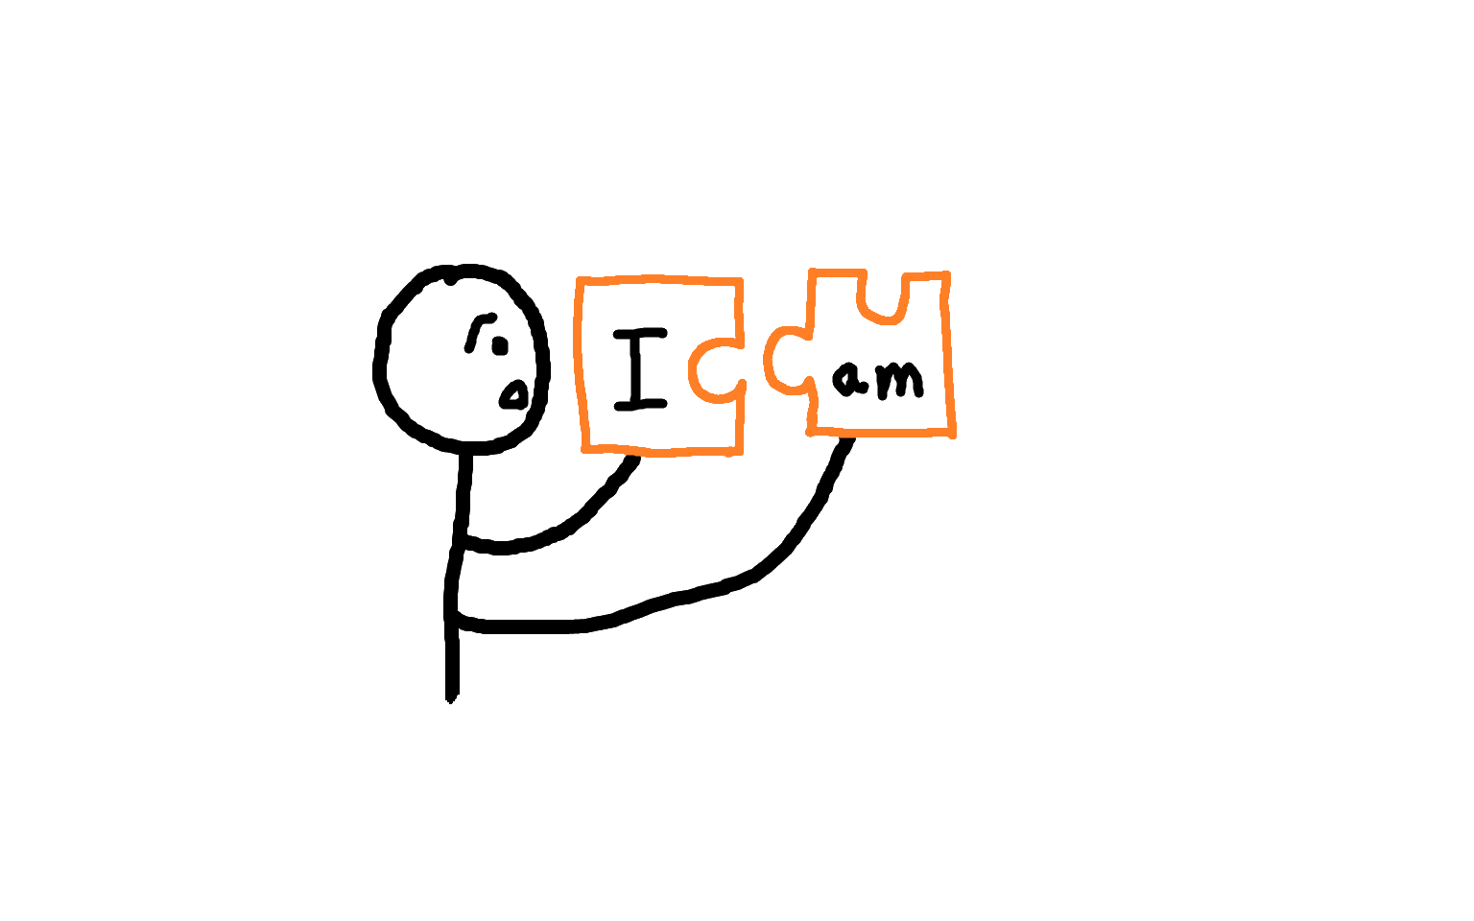

The monitor hypothesis
The monitor hypothesis claims that conscious learning can only function as a monitor or editor that checks and repairs the output of the acquired system (Krashen,1982).
Time
The learner needs time to think about and apply grammatical rules.
It is claimed that conscious learning is only limited to this function. Three factors create this limitation.
Focus on forms
If there is too much focus on correctness rather than fluency, it slows down the communication.
There are too many rules to know and apply before speaking.
Knowledge of the rules

Slide 7
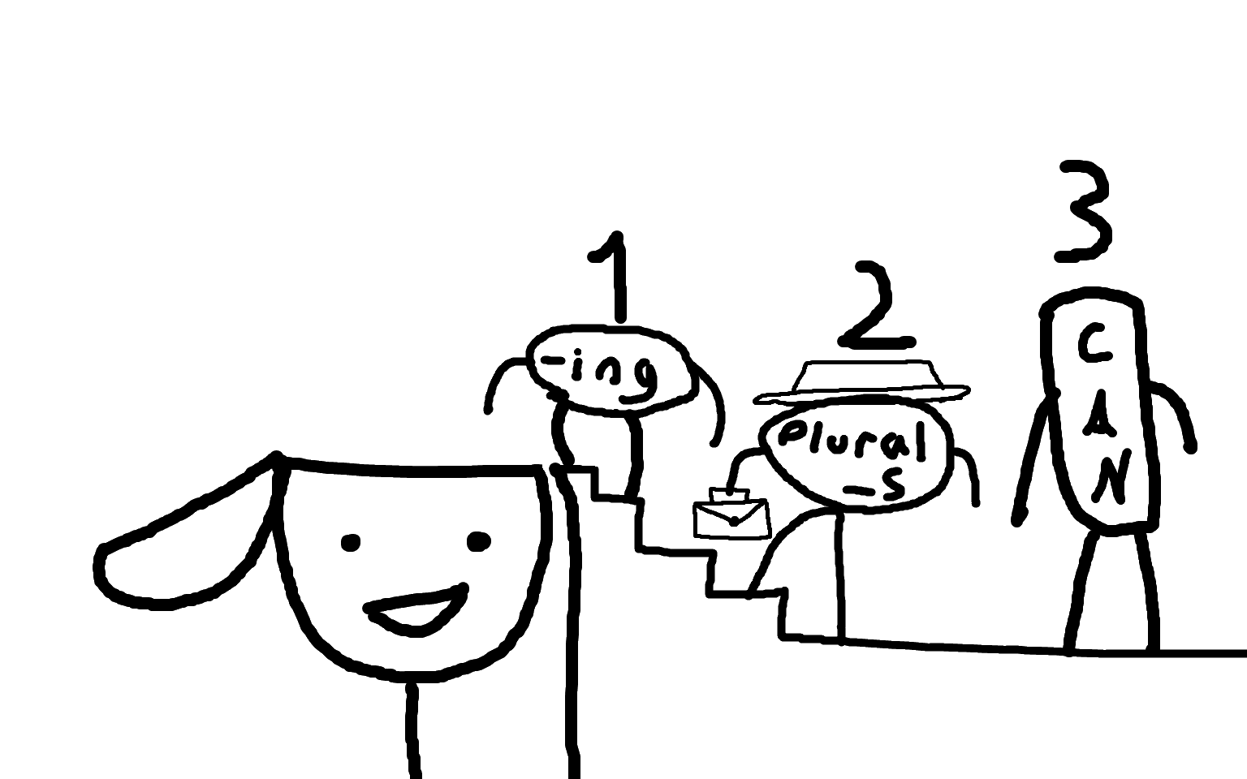
The natural order hypothesis
The natural order hypothesis states learners acquire grammatical structures in a predictable sequence. Don’t forget that the sequence is not fixed– there are factors that might interfere with it, such as the learner’s first language.
So according to the hypothesis, even if a teacher tries to teach “third-person singular –s” before “plural –s”, learners will still acquire them in the natural order.
Brown (1973) found that grammatical morphemes are acquired in the following order:
–ing (progressive)
Prepositions (in, on)
Plural –s
Irregular past tense
Possessive ‘s
Copula “be” (am/is/are as the main verb)
Articles
Regular past tense –ed
Third-person singular –s
NOTE: This study focused on L1 learners. However, later research revealed that L2 learners follow a similar order.

Slide 8


The input hypothesis
The hypothesis claim that people acquire language best by understanding input that is slightly beyond their current level of competence. If we take “i” as our current language level, then in order to acquire new elements in the language, we need input that is just a little more advanced – “i+1”. This means that any input students receive should ideally be comprehensible but slightly challenging.
For example, if a student knows the word “apple” but doesn’t yet know the names of colours in English, we can introduce them to an apple while saying, “This is a red apple.” Since student already understands “apple”, they can infer that “red” refers to the colour.
+
=
i
1
i+1

Slide 9

The affective filter hypothesis
Krashen (1983) believe that learner’s emotional state or attitudes as an adjustable filter that freely passes, impedes or blocks input necessary to acquisition. Motivation, self-confidence, and low-anxiety is key to acquiring a language effectively.

Slide 10


Key principles and characteristics of the Natural Approach
Goal
Theory of learning and language
Student and teacher roles
Low affective filter
Materials
Syllabus
Role of L1
Evaluation

Slide 11

Goal of the Natural Approach
NA primarily aims to make learners communicatively-competent.
It does so by,
Providing comprehensible input (i+1)
Lowering the affective filter
Creating an anxiety-free environment.
NA wants learners to acquire the language rather than learn it explicitly.
Krashen and Terrell (1983) state that the Natural Approach is designed for beginner learners to become intermediate learners.

Slide 12

Theory of learning
The Natural Approach is based on Krashen’s Second Language Acquisition Theory, which aligns with elements of cognitivism and constructivism.
Five key hypotheses of Krashen’s Second Language Acquisition
Monitor Hypothesis
Acquisition-Learning Hypothesis
Natural Order Hypothesis
Input Hypothesis
Affective Filter Hypothesis
Aligned with cognitivism: Input hypothesis suggests learning happens when learners process comprehensible input, similar to how cognitivism describe knowledge construction.
Aligned with constructivism: NA views language learning as a natural, experiential process where learners construct meaning through communication.

Slide 13

Theory of language
We can break down the theory of language in NA into four key elements.
Language is for communication: The primary purpose of language is to communicate.
Learning words (the lexicon) is more important than grammar. Grammar comes later.
Acquisition through comprehensible input: Learners progress by understanding language just above their current level, not by studying grammar rules.
Structure in language: Grammar exists, and it naturally comes with practice and exposure to language. There’s no need for explicit grammar instruction. The focus should be on communication.

Slide 14

Teacher Roles
Input Provider
Teacher is the primary source of the comprehensible input in the target language.
Facilitator
Teacher keeps the classroom atmosphere interesting and anxiety-free.
Orchestrator
Teacher orchestrates a wide range of activities across different groups and contexts.

Slide 15

Student/Learner Roles
Self-directed Learner
Learners take active role in their own learning journey. They should be able to decide when “grammar” should be a part in their program. However, note that grammar instruction is optional, students can study grammar if they want to refine their accuracy.
Goal Setter
Learners identify their language learning needs and decide what they want to achieve.
Self-paced Producer
Learners decide when to begin speaking and when to improve their speech.
Input Processor
Learners actively manage the language input they receive. They are expected to process comprehensible input they receive.
Active Communicator
Learners are expected to use the language. They should expose themselves to input as much as possible.
Students are expected to be autonomous and active.

Slide 16
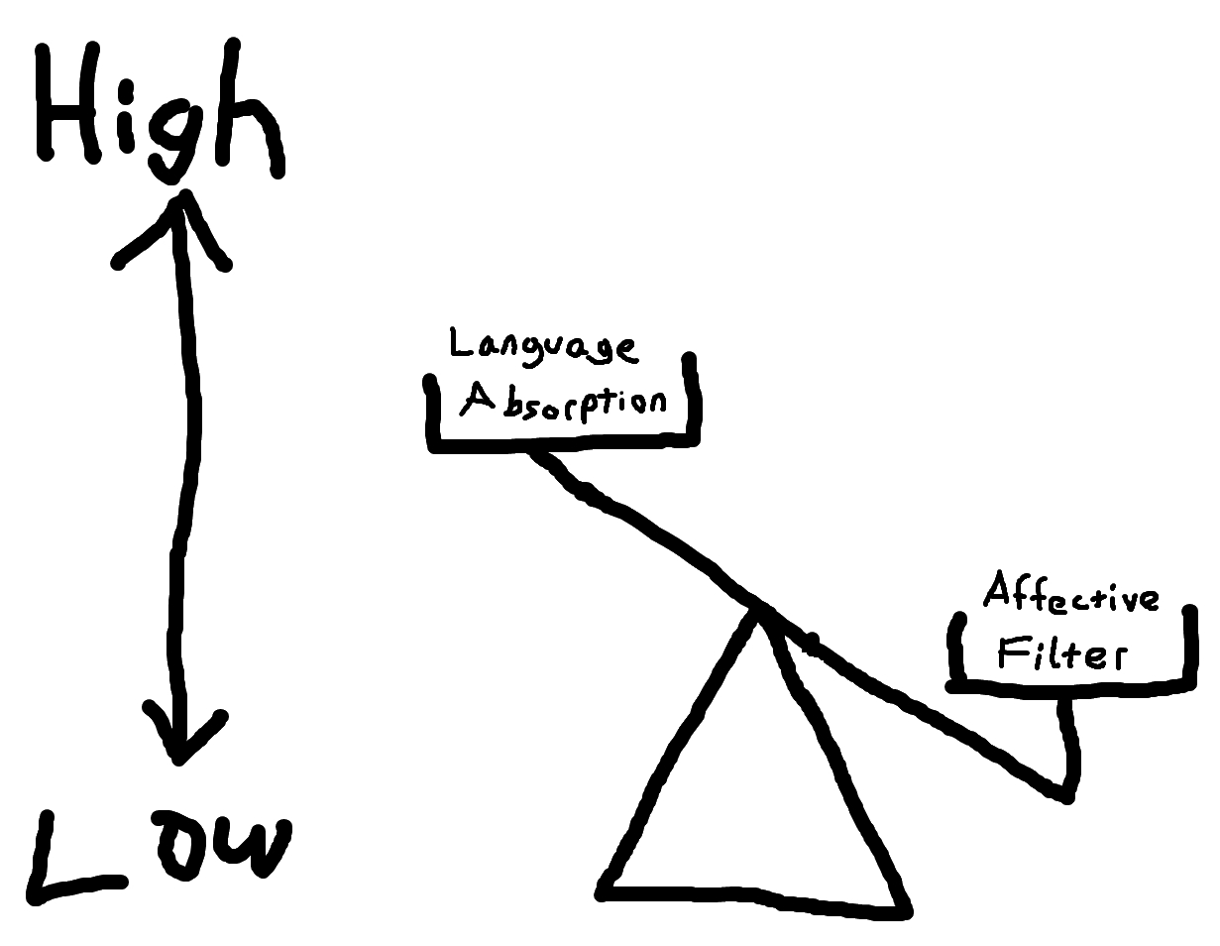
Low affective filter
A low affective filter occurs when learners feel relaxed, confident, and motivated. In this state, they are more likely to absorb and process language effectively.
NA does its best to maintain a low affective filter. For example,
It doesn’t pressure students to speak until they are ready.
It uses games, storytelling, and real-life contexts to help maintain motivation and confidence.

Slide 17

Materials
The primary goal of materials in the Natural approach is to make classroom activities as meaningful as possible by supplying “the extralinguistic context that helps acquirer to understand and thereby to acquire” (Krashen and Terrell 1983:55)
It can be inferred that aim of materials is to promote comprehension and communication.
Materials come from world of realia rather than from textbooks.
e.g. pictures, schedules, brochures, advertisements, maps, (also books!)

Slide 18

Syllabus
According to the Krashen and Terrell (1983), the syllabus should be organized based on two main factors: Communication goals and student needs and interests
1) Communication goals
NA is “designed to develop basic communication skills- both oral and written” Krashen and Terrell (1983:67). Therefore, a language course should focus on:
Oral and written personal communication skills
Oral and written academic learning skills
Communication goals can also be described using situations, functions and topics.
2) Student needs and interests
The goals of a Natural Approaches class are based on an assessment of student needs Krashen and Terrell (1983:71). Deriving from this, the syllabus content should align with students’ need and interests, create a low affective filter by being interesting, foster a relaxed atmosphere, provide extensive vocabulary exposure, and avoid focusing on grammatical structures.

Slide 19


Role of L1
L1 is not exactly forbidden or discouraged. However, since NA wants learners to be exposed into comprehensible input as much as possible, it is important that communication is in the target language.
Especially in the earlier phases of language learning, students are allowed to use their L1, and they are not reprimanded for it.

Slide 20

Evaluation
- How do we assess a student’s proficiency
WHAT
should we assess?
HOW
should we assess?
Terrell (1977) states that if goal is to communicate, students must be assessed based on their ability to communicate rather than their competence in grammar.
Terrell (1977) proposes that language tests must be oral and must target communicative competence.

Slide 21

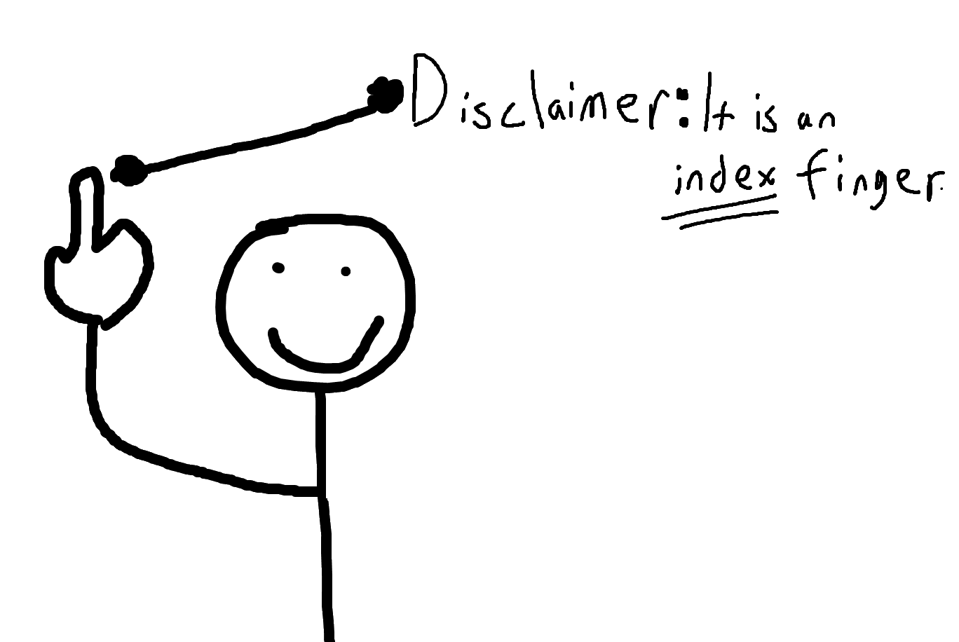
Now that you have a general understanding of the Natural Approach, choose the option that best aligns with it in the next slides.
If you think option A is correct,
raise five of your fingers.
If you think option B is correct,
raise only one of your fingers.

Slide 22

All errors are ______________.
A) directly corrected
B) not directly corrected
NA focuses on communication (and fluency) over accuracy, and directing all errors can hinder communication.
Over-correction can lead to anxiety in students, resulting in reduced language absorption.

Slide 23
NA focuses on ______ rather than ________.
A) form/meaning
B) meaning/form
Meaning stands for vocabulary, context, message and interpretation.
Form stands for sentence structure, tenses, pronunciation and grammar.
NA believes people pick up grammar naturally through input. So, it focuses on meaning rather than from.

Slide 24
_______ skills come first.
A) Receptive (listening and reading)
B) Productive (speaking and writing)
Learners need to understand the language before they can speak or write.
Listening and reading help learners pick up new words and grammar naturally.
It’s how we naturally learn language, just like babies first listen before speaking.

Slide 25
Students are ________________ in order to ________.
A) pressured to speak / avoid them from never producing the language.
B) not pressured to speak / reduce anxiety in students, which enhances language absorption.
It’s how we naturally learn language, just like babies first listen before speaking.

Slide 26
Which two methods are more similar to the Natural Approach?
A) Total Physical Response and Communicative Language Teaching
B) Direct Method and Community Language Learning

Slide 27
Do not confuse Direct Method and the Natural Approach!
The Direct Method is also known as the “Natural Method” but it is not the same thing as the Natural Approach!
Even though they share some features, there are differences!
 | The Direct Method | The Natural Approach
Role of L1 | Strictly prohibited | Allowed
Errors | Corrected immediately | Tolerated
Student feelings | Are NOT taken into account | Are taken into account
Student participation | Primarily listens, speaks when ready | Actively participates in speaking

Slide 28
Articles that we are going to take inspect today
1) Tehrani, A. R., Barati, H., & Youhanaee, M. (2013). The effect of methodology on learning vocabulary and communication skills in Iranian young learners: A comparison between audiolingual method and natural approach. Theory and Practice in Language Studies, 3(6), 968–976.
2) Uzoqova, M. S. (2024). Natural approach techniques in learning a new language. Pedagogika, Psixologiya va Ijtimoiy Tadqiqotlar, 3(7), 85–89.

Slide 29
The effect of methodology on learning vocabulary and communication skills in Iranian young learners: A comparison between audiolingual method and natural approach.
You can access the article by clicking here.
After taking a look on the article, we will break it down in the next slides.

Slide 30
This article seeks to answer two questions:
1) Are audiolingual method and natural approach significantly different in the acquisition of English vocabulary for EFL young learners?
2)Do EFL young learners communicate better in English through Audiolingual method or Natural Approach?
To answer these questions, researchers conducted an experiment involving 40 randomly selected Iranian female young learners aged 7 to 9, enrolled in grades 1,2, and 3 of elementary school.
The participants were divided into two groups(20/20) and were taught English at two separate schools. In one school, the Audiolingual Method was used, while in the other, the Natural Approach was used.
After the course, a final test was administered to assess the effectiveness of each method.

Slide 31
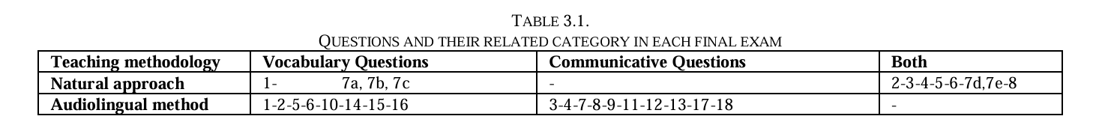
The final tests administered in both schools differed from each other. The details are presented in the table below.
Method | Number of Questions | Question Types
Natural Approach | 8 | 2 matching pictures with correct answers
 |  | 5 drawing and colouring
 |  | 1 multiple-choice question (visual)
Audiolingual Method | 18 | 4 wh-questions
 |  | 4 yes/no questions
 |  | 8 fill-in-the-blank questions
Later on, the questions in these two tests were categorized into vocabulary and communicative sections, as shown in the table below.

Slide 32
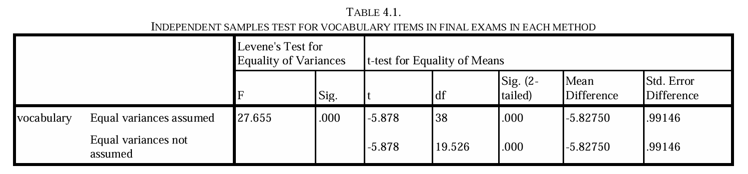
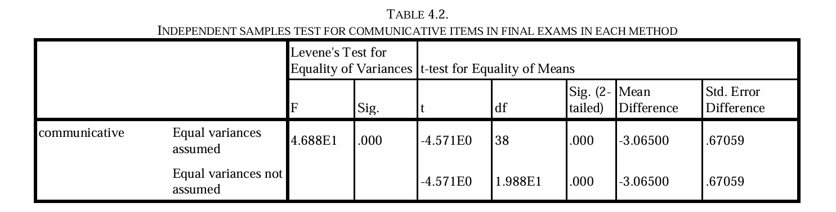
For vocabulary acquisition, the results favored the Natural Approach, with a mean difference of -5.82~, which was found to be statistically significant.
For communication, the results also favored the Natural Approach, with a
-3.06~ mean difference.

Slide 33
From this article, it can be inferred that the Natural Approach is more efficient when it comes to vocabulary acquisition and communication skills.

Slide 34
“Natural Approach Techniques in Learning A New Language” Article
You can access the article by clicking here.
After taking a look on the article, we will break it down in the next slides.

Slide 35
This article has three objectives:
1) To assess the effectiveness of Natural Approach techniques in improving language proficiency.
2) To compare the engagement and satisfaction levels of learners using Natural Approach techniques with those using traditional language learning methods
3) To evaluate the potential benefits and limitations of the Natural Approach in a contemporary language learning context.
To fulfil their objectives, researchers conducted an experiment involving 120 intermediate level participants aged 18 to 30.
The participants were randomly assigned into two groups and taught English. One group used conventional language learning methods, while the other group used the Natural Approach.
In the study, a pre-test and a post-test were used to measure language proficiency, along with surveys to assess engagement and satisfaction.

Slide 36
There are no additional details about the pre-test, post-test, or surveys; however, the materials and techniques used are specified.
Group | Materials/Techniques Used
The Traditional Learning Group | textbooks, grammar workbooks, vocabulary lists
The Natural Approach Group | role-plays, storytelling sessions, conversational practice with natives
And about the results,
“The results of this study reveal that the Natural Approach techniques led to greater improvements in language proficiency compared to traditional methods. The Natural Approach group showed a significant increase in all areas of language skills, with average post-test scores improving by 30% across listening, speaking, reading, and writing, while the traditional group showed a 15% improvement.”

Slide 37
“Engagement and satisfaction surveys also highlighted the advantages of the Natural Approach, with 90% of participants in the Natural Approach group reporting high levels of motivation and enjoyment, compared to 65% in the traditional group.”
“The study also acknowledges some limitations. The sample size was relatively small and homogeneous, which may affect the generalizability of the findings. Future research should involve a larger and more diverse sample to validate the effectiveness of Natural Approach techniques across different learner populations and contexts. Additionally, the study's duration was limited to ten weeks, which may not capture the long-term effects of the Natural Approach. Longer-term studies are needed to assess the sustained impact of these techniques on language proficiency and retention.”

Slide 38
From this article, it can be inferred that the Natural Approach techniques offer a promising alternative to traditional language instruction methods. By focusing on natural language acquisition through comprehensible input, communicative activities, and immersive experiences, these techniques can significantly enhance language proficiency and learner engagement.

Slide 39

References
Brown, R. (1973). A first language: The early stages. Harvard University Press.
Krashen, S. D., & Terrell, T. D. (1983). The natural approach: Language acquisition in the classroom. Prentice Hall.
Tehrani, A. R., Barati, H., & Youhanaee, M. (2013). The effect of methodology on learning vocabulary and communication skills in Iranian young learners: A comparison between audiolingual method and natural approach. Theory and Practice in Language Studies, 3(6), 968–976.
Richards, J. C., & Rodgers, T. S. (2001). Approaches and methods in language teaching (2nd ed.). Cambridge University Press.
Toprak, T. E. (2019). The Natural Approach. Retrieved from https://www.researchgate.net/publication/335466055
Uzoqova, M. S. (2024). Natural approach techniques in learning a new language. Pedagogika, Psixologiya va Ijtimoiy Tadqiqotlar, 3(7), 85–89.

Slide 40

Thank you for your time!
End of the presentation.

